Slide 1
CLASS OF
2023

Slide 2
People to Know
Principal- Dr. Ley Hathcock
Assistant Principals- Mrs. Amy Brock
Dr. Ean Sonnier
Mr. Wagner
Counselors- Mrs. Jessica Diedrich, A-K
Mrs. Erica Hughes, L-Z
Graduation Coach- Mrs. Cindy Herford

Slide 3
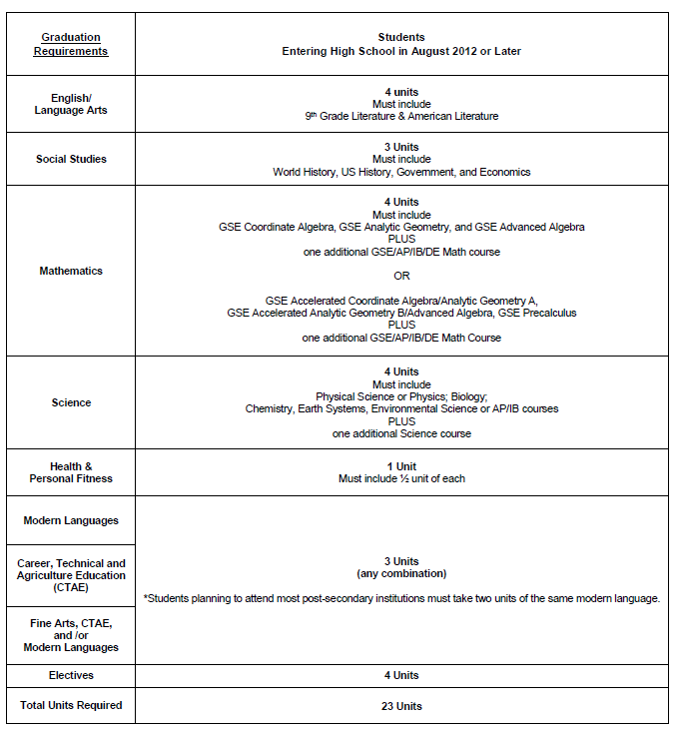
Graduation Requirements

Slide 4
Grade Promotion
Notes:
Summer school- credit recovery, month of June, costs money

Slide 5
Grading
Grades are split 60% tests, 40% daily work
Must earn a minimum of a 70 (C) average to earn credit
F’s = No credit, effects athletic eligibility, grade promotion, graduation, college acceptance, scholarships, etc.
PPPA/EOC/Final = 20% of second semester grade
EOCS- Algebra, Geometry, 9th grade Literature, American Literature, US History, Economics, Biology, and Physical Science
Notes:
Grades for athletics are checked for eligibility at the 18 week grading period (beginning of January). Students must be passing 5 out of 7 courses and be on track to graduate to play a sport.

Slide 6
Academic Supports
Daily RTI / Flextime
Before & afterschool tutoring
Yearly math support courses
Online reading and math (RTI interventions)
Weekly advisement
Unit/credit recovery (E2020)
Graduation Coach / Counselors

Slide 7
Student Responsibility
Complete all class work and home work on time
Have good attendance
Be responsible to get your makeup work if absent
Ask for extra help
Check teacher websites (CANVAS)
Do not be afraid to email your teachers
Take advantage of tutoring opportunities
Write down assignments and deadlines
Agenda planner given

Slide 8
College/Scholarships
Colleges accept students based on their academic history for grades 9-11 and monitor them throughout their senior year
HOPE Scholarship
HOPE GPA of 3.0 +
HOPE GPA only includes academic core courses and language courses
4 rigors
Courses taken in MS do not count toward HOPE GPA & rigor

Slide 9
2019 Bell Schedule
Monday
1st 8:20 – 9:10
2nd 9:15 – 10:00
ADVISEMENT 10:05 – 10:25
3rd 10:30 – 11:15
4th 11:20 – 1:00
LUNCH A(11:20) B(11:45) 11:50 C(12:10) 12:15 D(12:35) 12:40
5th 1:05 – 1:50
6th 1:55 – 2:40
7th 2:45 – 3:35

Slide 10
2019 Bell Schedule
Tuesday / Thursday
1st 8:20 – 10:00
3rd 10:05 – 12:55
Lunch A(11:15) B(11:50) C(12:25)
5th 1:00 – 2:40
7th 2:45 – 3:35
Wednesday / Friday
2nd 8:20 – 10:00
4th 10:05 – 12:55
Lunch A(11:15) B(11:50) C(12:25)
6th 1:00 – 2:40
7th 2:45 – 3:35

Slide 11
Registration Timeline
December- Program of Choice applications due (World Scholars and I2)
Week of January 14- 8th grade teachers made academic recommendations
January 24- parent/guardian information session
January 29 & 30- WHMS students tour WHHS and select electives
February 15- Program of Choice notification sent out
March- receive course requests
July- master schedule created
August 1- pick up schedule at orientation

Slide 12
Typical 9th grade Schedule
English
Math
Science
History
Health / PE – one course per semester
Elective*
Elective*
Please note-
a recommendation for math support will take up one class period
attending LCCA takes up two class periods
2 years of the same modern language is required to attend a 4 year college/university

Slide 13
Electives
Additional PE
Fine Arts
Modern Language
CTAE at WHHS
CTAE at LCCA *takes up 2 class periods
*bussed to a different building

Slide 14
Career Tech
Notes:
Available CTAE courses at WHHS and LCCA

Slide 15
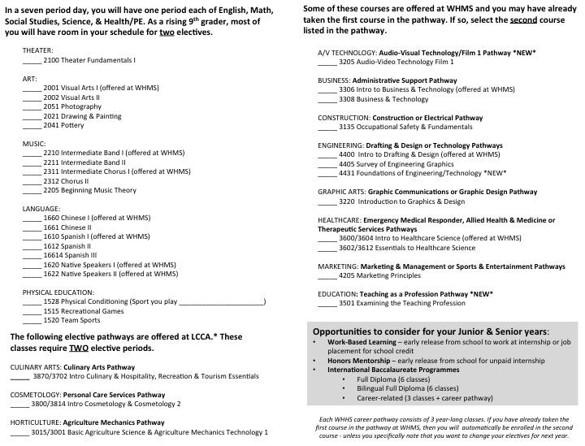
Notes:
Students will receive a similar looking sheet to select electives on January 29 and 30.

Slide 16
Future Opportunities
IB
Dual enrollment
Work-based learning
Honors Mentorship

Slide 17
Stay Informed
Website- whhs.hallco.org
Remind
Parent portal/Infinite Campus
Canvas- https://hallco.instructure.com/courses/48947
Social Media
Instagram- wh_spartans & whhs_guidance
Twitter- @WH_Spartans & @WHHSGuidance

